Slide 1


Computer Networks X_400487
Lecture 5
Chapter 4: Medium Access Control
Lecturer: Jesse Donkervliet
Includes slides from Vlad Cursaru

Slide 2
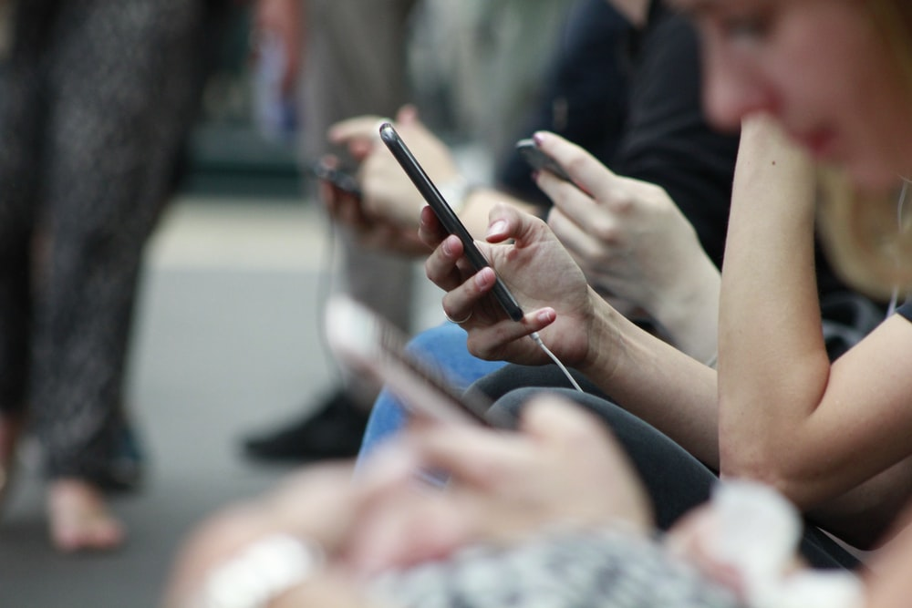
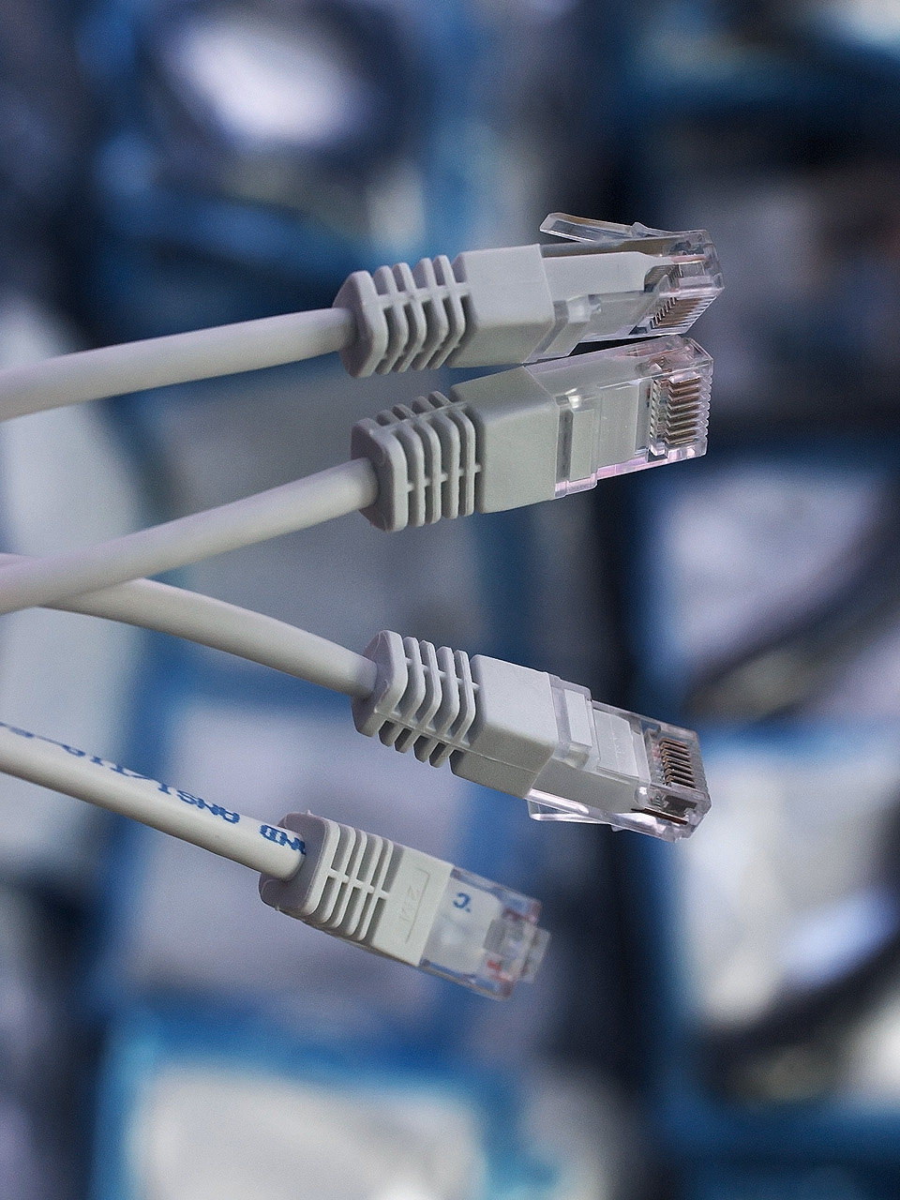


IEEE 802.3
IEEE 802.11

Slide 3
The MAC sublayer Medium Access Control
Lower part of the Data link layer.
Responsible for deciding who can use the communication channel.
Application layer
Transport layer
Network Layer
Data link layer
You are here
Medium Access Control
Physical layer

Slide 4


Didn’t we solve this at the Physical Layer???
A, video
B, video
C, www
D, email
A
Inefficient resource usage
B
C
D

Slide 5
Didn’t we solve this at the Physical Layer???
A
B
C
D
…
A
Video streaming no longer works
B
C
D

Slide 6
MAC Sublayer Outline
ALOHA & Slotted ALOHA
CSMA
1-persistent
nonpersistent
p-persistent
CSMA/CD
802.3 Ethernet
Ethernet Switching
MAC for Wireless
Hidden Terminal
Exposed Terminal
CSMA/CA
802.11 WiFi
Collision-Free Protocols
Basic Bit-Map
Token Ring
Binary Countdown

Slide 7
Two Approaches: Contend or Coordinate
Contend
If there is data to send, send it!
Collisions are a fact of life.
Keep trying until sending succeeds.
Coordinate
If there is data to send, let other stations know.
Send when it is your turn.
Patiently wait while other stations are sending.
Q: When to apply which strategy?
Protocols somewhere along the spectrum

Slide 8



Slide 9
ALOHA
Q: When does ALOHA perform well/badly?
In pure ALOHA, users transmit frames whenever they have data; if a collision occurs, users retry after a random delay.
A
M
B
M
Collision
Stations
C
These stations use the same channel without mutiplexing on the physical layer.
D
E
M
Time

Slide 10
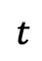
Collisions in ALOHA
$$t$$
M
Collision
M
Time

Slide 11
Collisions in ALOHA
$$t$$
Collision
M
M
Time

Slide 12
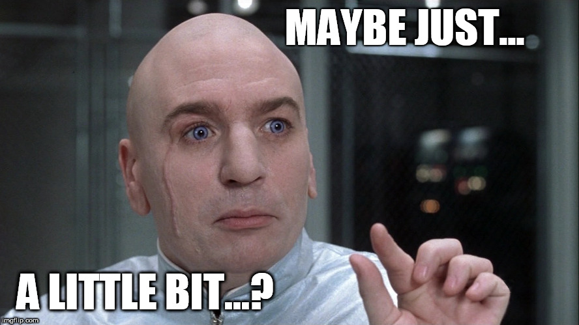

Collisions in ALOHA
Frame collisions can occur anywhere within 2 times duration of transmission.
$$2×t$$
If another frame is sent anywhere in this period, a collision occurs
$$t$$
Collision
M
M
Time

Slide 13

Pure ALOHA
All of these messages will have to be retransmitted!
Q: How can we reduce the risk of collision?
Collisions
M
M
Stations
M
Time

Slide 14
Slotted ALOHA
These messages will have to be retransmitted!
First frame sent successfully
M
M
Stations
Probability of frame collisions is reduced. Frames now overlap completely, or not at all.
M
Time

Slide 15
Carrier Sense Multiple Access

Slide 16
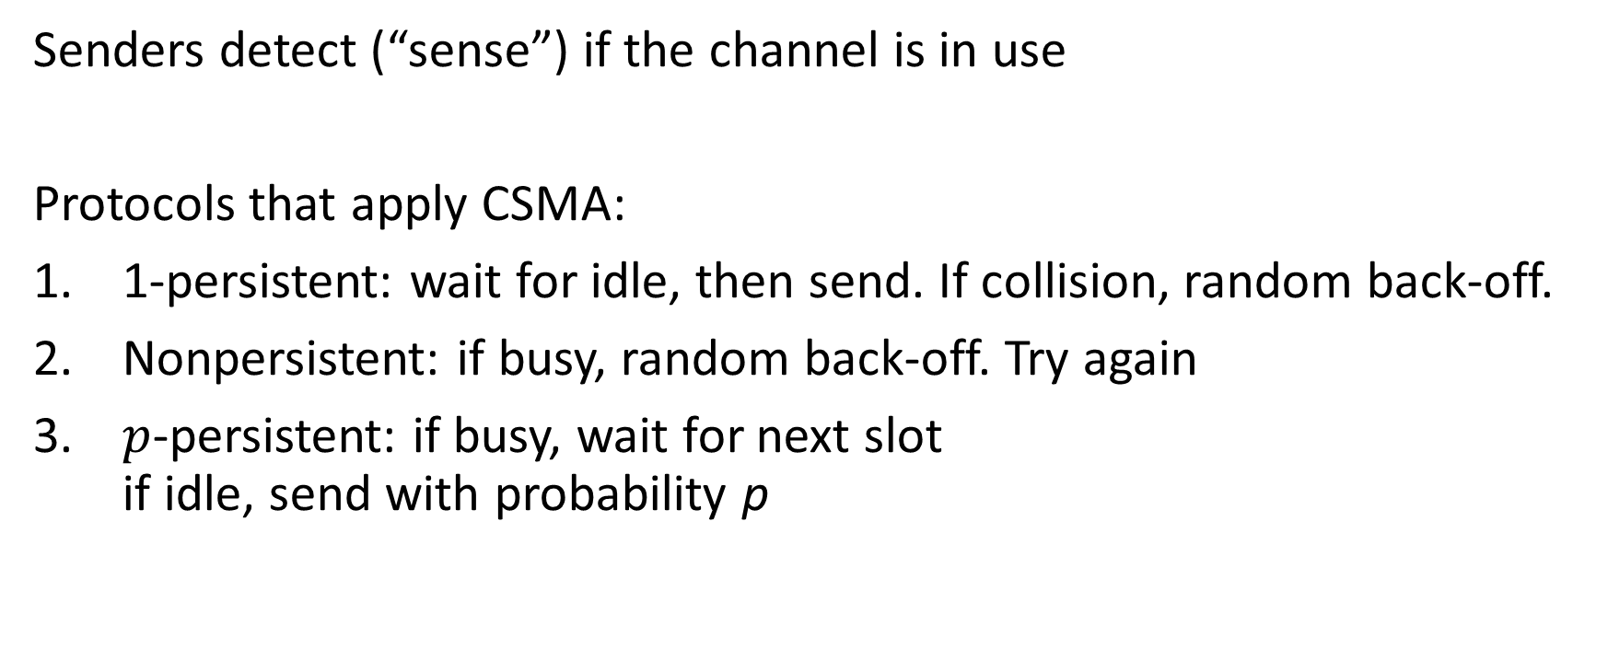
Carrier-Sense Multiple Access
Senders detect (“sense”) if the channel is in use
Protocols that apply CSMA:
1-persistent: wait for idle, then send. If collision, random back-off.
Nonpersistent: if busy, random back-off. Try again
$p$-persistent: if busy, wait for next slot if idle, send with probability p

Slide 17
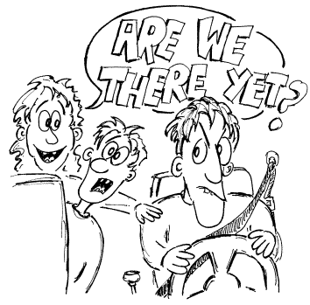
1-persistent CSMA
Channel free?
No
Yes
Random back-off
Send
Collision?
Yes
Wait until the channel is idle, then send
No
Q: Can you think of a problem with this method?

Slide 18
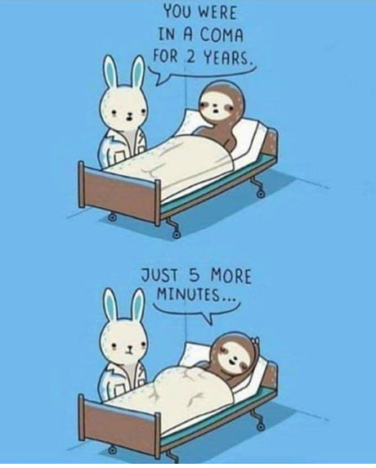
Nonpersistent CSMA
Channel free?
No
Yes
Random back-off
Send
Collision?
Yes
Nonpersistent CSMA is less greedy. If the channel is occupied, it waits a random amount of time
No
Q: Can you think of a problem with this method?

Slide 19
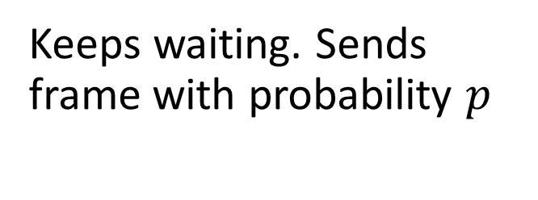
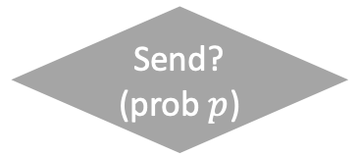
p-persistent CSMA
Channel free?
Skip slot
Applies to slotted channels.
No
Yes
Random back-off
Send? (prob $p$)
Skip slot
No
Yes
No
Channel free?
Yes
Send
Keeps waiting. Sends frame with probability $p$
Yes
Collision?

Slide 20
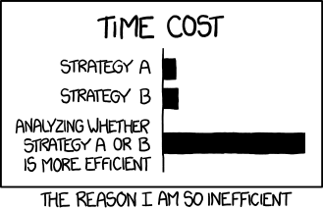
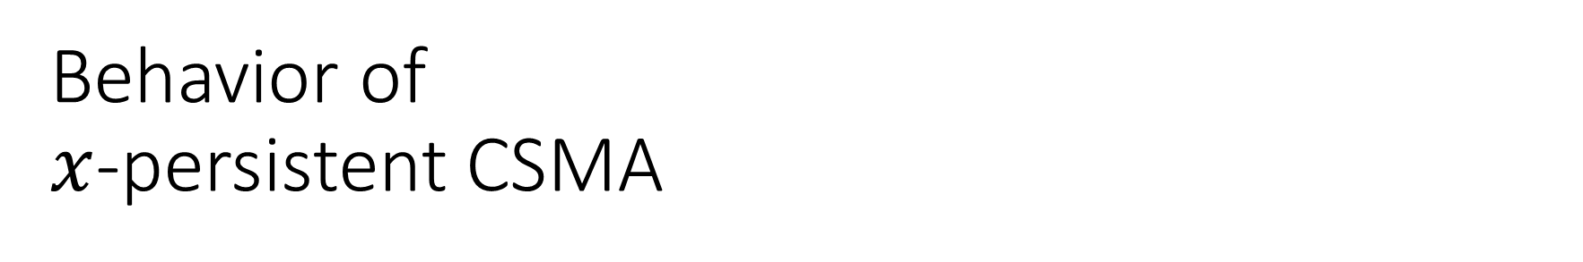
Behavior of $x$-persistent CSMA
Q: What trade-off do these protocols make?
Latency, bandwidth, (protocol) complexity
Early computer networks research evaluated protocol performance theoretically, using assumptions such as packet arrivals following Poisson distributions. Empirical research showed this not to be the case.* We still(!) lack mathematical tools to describe the behavior of these systems, and instead rely on observing the behavior of these systems “in the wild.”

Slide 21
MAC Sublayer Outline
ALOHA & Slotted ALOHA
CSMA
1-persistent
nonpersistent
p-persistent
CSMA/CD
802.3 Ethernet
Ethernet Switching
MAC for Wireless
Hidden Terminal
Exposed Terminal
CSMA/CA
802.11 WiFi
Collision-Free Protocols
Basic Bit-Map
Token Ring
Binary Countdown

Slide 22
CSMA/CD
Carrier Sense Multiple Access with Collision Detection

Slide 23
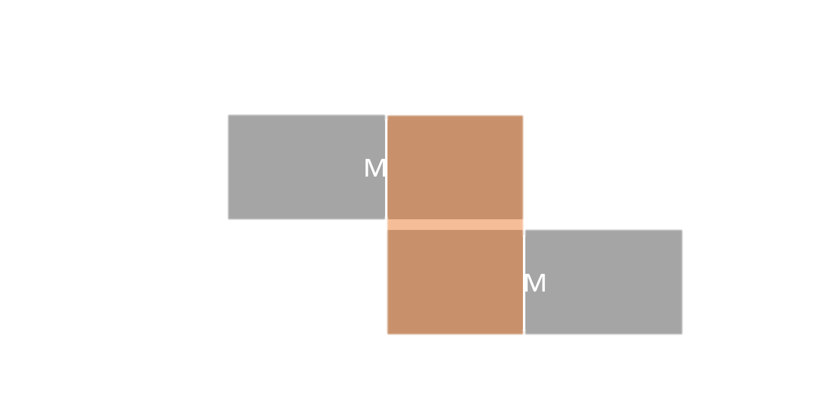
CSMA/CD: CSMA with Collision Detection
Remember?
Idea: when collision is detected, do not finish sending. Stop transmission instead.
Separates contention periods from transmission periods.
Contention period: check if it is safe to send data.
Transmission period: send data.
Saves time and bandwidth

Slide 24
Collision detection
Abort transmission when collision is detected.
A station is transmitting
Afterwards, other stations try to claim the channel.
A station transmits. No collision, channel claimed.
frame
frame
frame

Slide 25
Collision detection
Reduce contention period duration to improve throughput
Abort transmission when collision is detected.
Q: How do longer frames affect throughput? How about latency?
frame
frame
frame

Slide 26
MAC Sublayer Outline
ALOHA & Slotted ALOHA
CSMA
1-persistent
nonpersistent
p-persistent
CSMA/CD
802.3 Ethernet
Ethernet Switching
MAC for Wireless
Hidden Terminal
Exposed Terminal
CSMA/CA
802.11 WiFi
Collision-Free Protocols
Basic Bit-Map
Token Ring
Binary Countdown

Slide 27
Medium Access Control Classic Ethernet

Slide 28
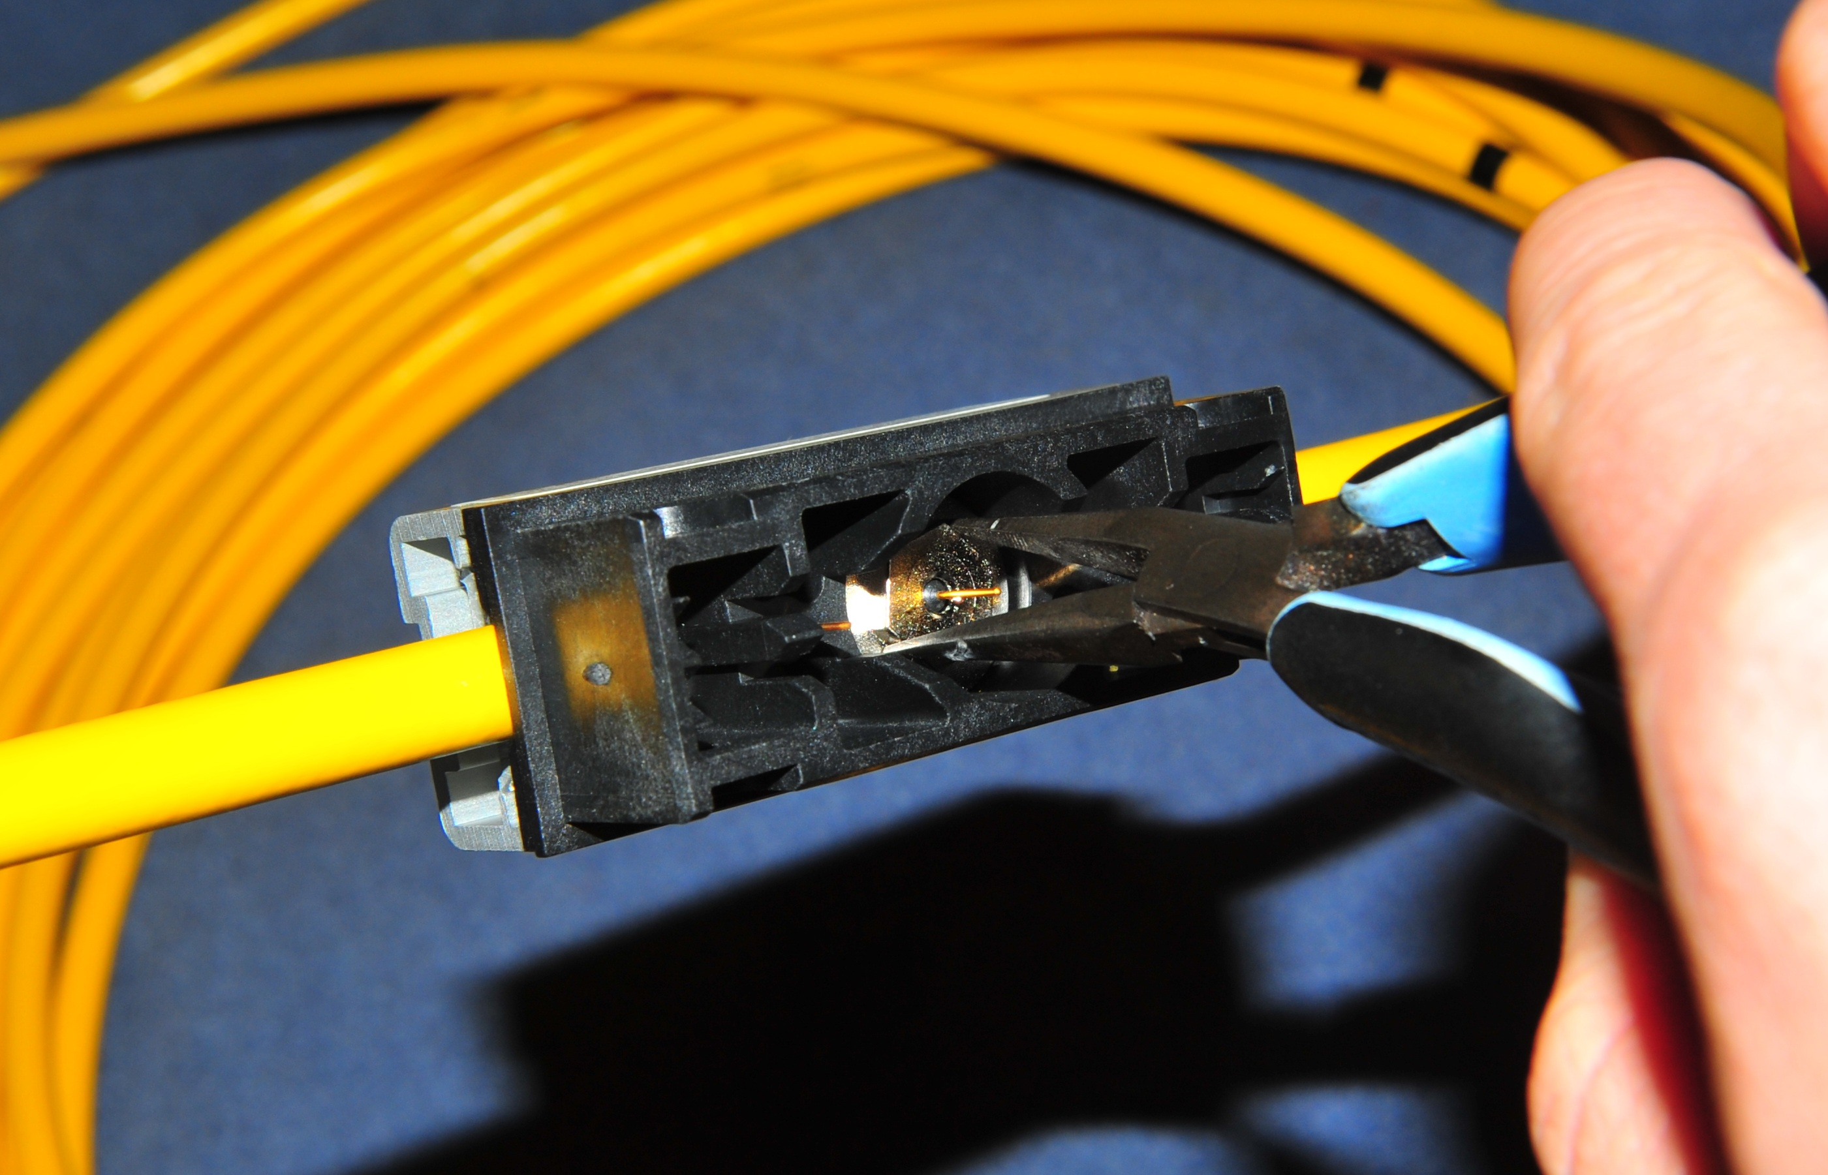
Medium Access Control in … Classic Ethernet
Multiple machines sharing a single Ethernet connection.

Slide 29

Medium Access Control in … Classic Ethernet
Multiple machines sharing a single Ethernet connection.
Q: Which MAC protocol should we use?
Newer versions of Ethernet (10-gigabit Ethernet and up) only support point-to-point full-duplex operation.

Slide 30
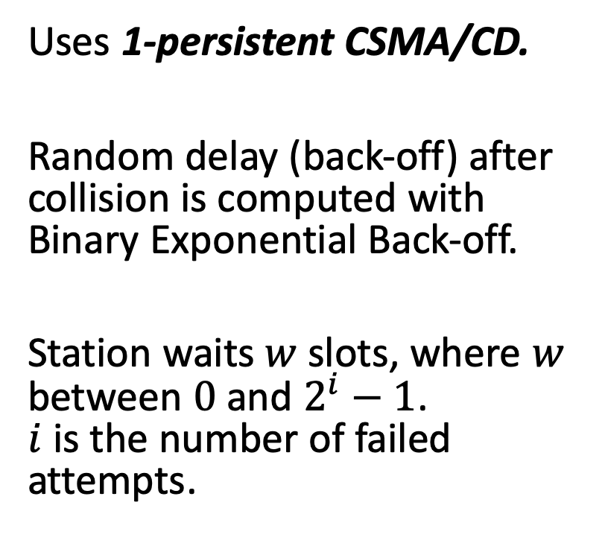
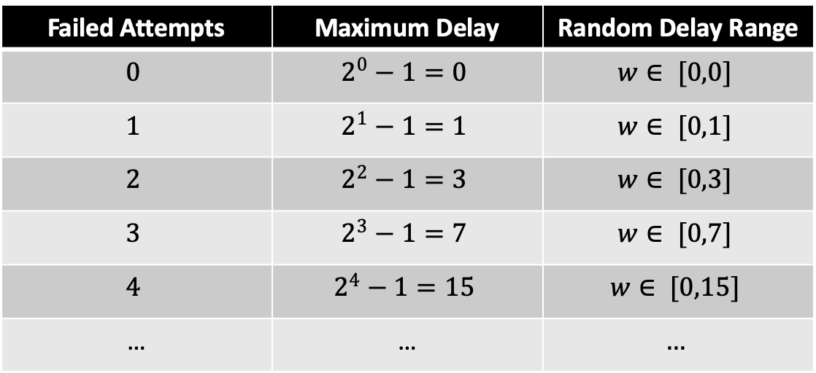
Medium Access Control in … Classic Ethernet
Failed Attempts | Maximum Delay | Random Delay Range
$$0$$ | $$2^{0}−1=0$$ | $$w∈ [0,0]$$
$$1$$ | $$2^{1}−1=1$$ | $$w∈ [0,1]$$
$$2$$ | $$2^{2}−1=3$$ | $$w∈ [0,3]$$
$$3$$ | $$2^{3}−1=7$$ | $$w∈ [0,7]$$
$$4$$ | $$2^{4}−1=15$$ | $$w∈ [0,15]$$
… | … | $$…$$
Uses 1-persistent CSMA/CD.
Random delay (back-off) after collision is computed with Binary Exponential Back-off.
Station waits $w$ slots, where $w$ between $0$ and $2^{i}−1$. $i$ is the number of failed attempts.
maxw = 0
collision = True
while collision:
w = random.randint(0, maxw)
collision = delayed_send(frame, w)
if collision:
maxw = maxw << 1
maxw = maxw | 1
Q: What happens if more than 2 stations are trying to send a frame?

Slide 31
Ethernet performance
Q: What is more bandwidth efficient? Why?
Q: Is there a trade-off here? Why?
Small frames
frame
frame
frame
Contention periods
frame
frame
frame
Large frames
Less time claiming channel → more time sending data

Slide 32


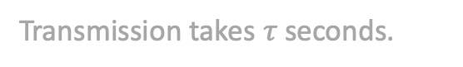
Classic Ethernet Collision detection
Q: Does the detection latency cause a problem?
Collisions can occur and take as long as 2τ to detect.
τ is the time it takes to propagate over the Ethernet.
Leads to minimum packet size for reliable detection.
M
M
M
Ethernet
Transmission takes $τ$ seconds.

Slide 33
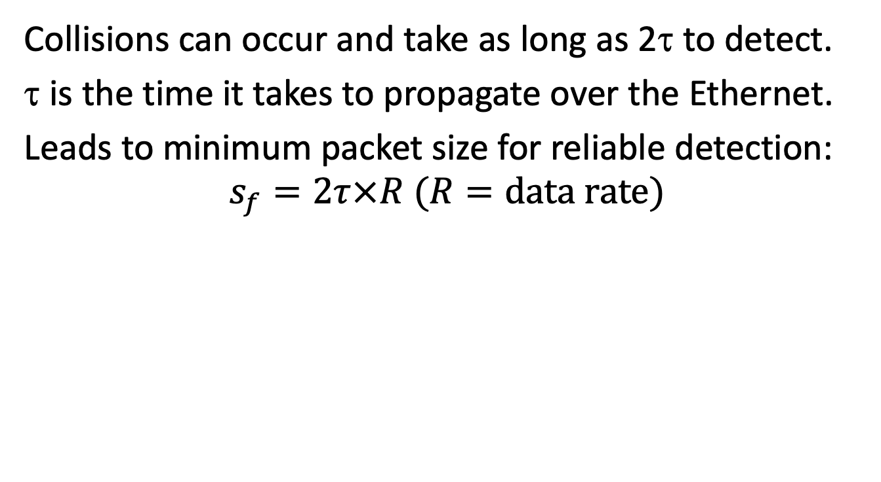
Classic Ethernet Collision detection
Q: Does the detection latency cause a problem?
Collisions can occur and take as long as 2τ to detect.
τ is the time it takes to propagate over the Ethernet.
Leads to minimum packet size for reliable detection:
$$s_{f}=2τ×R (R=\text{data} \text{rate})$$
M
M
Ethernet
Transmission takes $τ$ seconds.
$$τ=5\text{μs}, R=500\text{Mbps}, S_{f}=2×5\text{μs}×500\text{Mbps}=5000 \text{bits}$$

Slide 34
Ethernet frames
Frame format still used in modern versions of Ethernet.*
Preamble
Destination
address
Source
address
T/L
Data
P
CRC
Bytes: 8
6
6
2
0-1500
0-46
4
*VLAN-aware packets from 802.1Q use a slightly modified header.

Slide 35
Ethernet frames
Frame format still used in modern versions of Ethernet.*
Bit-sequence used to indicate start of frame.
Preamble
Destination
address
Source
address
T/L
Data
P
CRC
Bytes: 8
6
6
2
0-1500
0-46
4
*VLAN-aware packets from 802.1Q use a slightly modified header.

Slide 36
Ethernet frames
Frame format still used in modern versions of Ethernet.*
Source and destination addresses.
Preamble
Destination
address
Source
address
T/L
Data
P
CRC
Bytes: 8
6
6
2
0-1500
0-46
4
Q: Why needed over a single link?
Q: What is the name of this address? What is it assigned to?
*VLAN-aware packets from 802.1Q use a slightly modified header.

Slide 37
Ethernet frames
Frame format still used in modern versions of Ethernet.*
Type/length field:
Indicates to which network layer protocol the data should be sent.
Values less than 0x600 (1536) can be interpreted as length. (IEEE 802.3 only)
Preamble
Destination
address
Source
address
T/L
Data
P
CRC
Bytes: 8
6
6
2
0-1500
0-46
4
*VLAN-aware packets from 802.1Q use a slightly modified header.

Slide 38
Ethernet frames
Frame format still used in modern versions of Ethernet.*
Pad field:
Used if data causes frame to be less than the minimum frame length.
Preamble
Destination
address
Source
address
T/L
Data
P
CRC
Bytes: 8
6
6
2
0-1500
0-46
4
*VLAN-aware packets from 802.1Q use a slightly modified header.

Slide 39
Ethernet frames
Q: Reliable delivery?
Frame format still used in modern versions of Ethernet.*
32-bit Cyclic Redundancy Check used for error detection.
Preamble
Destination
address
Source
address
T/L
Data
P
CRC
No acks!
Bytes: 8
6
6
2
0-1500
0-46
4
Q: Error detection/correction?
Q: How long is the generator polynomial?
*VLAN-aware packets from 802.1Q use a slightly modified header.

Slide 40
Data Link Layer Switching

Slide 41
Switching Classic Ethernet
Remember?
A
B
C
D

Slide 42
Switching Classic Ethernet with Hubs
A
B
C
D
Hub

Slide 43
Switching Classic Ethernet with ✨Switches✨
Q: Do we still need MAC?
Same network topology, but MAC protocol no longer needed, if the channel is duplex!
A
B
C
D
Switch

Slide 44
Ethernet evolution From hubs to switches
Classic Ethernet
Fast Ethernet
Gigabit Ethernet
10-Gigabit Ethernet
Hub
Switch
All ports/ wires are always
connected
…

Slide 45
Ethernet switch
Q: Advantages of switches?
3. Send out on correct port
Switch
1
Frame buffer
From: A
To: C
2
C
2. Look up destination
3
Hash table
Port #2
4
1. Placed in buffer
From: A
To: C
8

Slide 46
Learning bridges Backwards learning
Hash table:
A:1
B:3
Switch
From: B
To: A
From: A
To: C
From: A
To: C
From: A
To: C
1
2
3
4
From: A
To: C
From: B
To: A

Slide 47
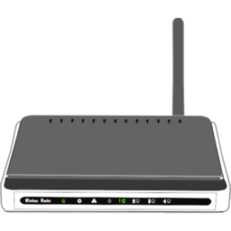
Ethernet Wiring pattern
Switch
Router
To ISP
Switches can connect to other switches
Switch

Slide 48
Learning bridges Topology with loops
Router
To ISP
Switch
Switch
Network contains a loop
Q: What kind of problem can this cause?

Slide 49
Spanning tree Example
No direct loops
Switch
Switch
Switch
Switch
Switch

Slide 50
Spanning tree Example
No direct loops
Switch
Switch
Switch
Switch
Switch
Only links in spanning tree are used. Others ignored

Slide 51
Spanning tree algorithm As a poem
Selected as root.
Q: Which metric to use for link cost?
Switch
I think that I shall never see
A graph more lovely than a tree.
A tree whose crucial property
Is loop-free connectivity.
A tree which must be sure to span.
So packets can reach every LAN.
First the Root must be selected
By ID it is elected.
Least cost paths from Root are traced
In the tree these paths are placed.
A mesh is made by folks like me
Then bridges find a spanning tree.
– Radia Perlman, 1985.
2
M
M
3
Switch
M
M
Switch
M
6
2
M
M
M
8
M
Switch
Switch
M
M
7
M
4
M
3
M
Nodes select shortest path to root.
Switch
M
M
Switch

Slide 52
Spanning tree algorithm As a poem
Selected as root.
Switch
I think that I shall never see
A graph more lovely than a tree.
A tree whose crucial property
Is loop-free connectivity.
A tree which must be sure to span.
So packets can reach every LAN.
First the Root must be selected
By ID it is elected.
Least cost paths from Root are traced
In the tree these paths are placed.
A mesh is made by folks like me
Then bridges find a spanning tree.
– Radia Perlman, 1985.
2
3
Switch
Switch
6
Remaining links not used!
2
Switch
8
Switch
7
4
3
Nodes select shortest path to root.
Switch
Switch

Slide 53
MAC Sublayer Outline
ALOHA & Slotted ALOHA
CSMA
1-persistent
nonpersistent
p-persistent
CSMA/CD
802.3 Ethernet
Ethernet Switching
MAC for Wireless
Hidden Terminal
Exposed Terminal
CSMA/CA
802.11 WiFi
Collision-Free Protocols
Basic Bit-Map
Token Ring
Binary Countdown

Slide 54
Medium Access Control for Wireless Channels

Slide 55
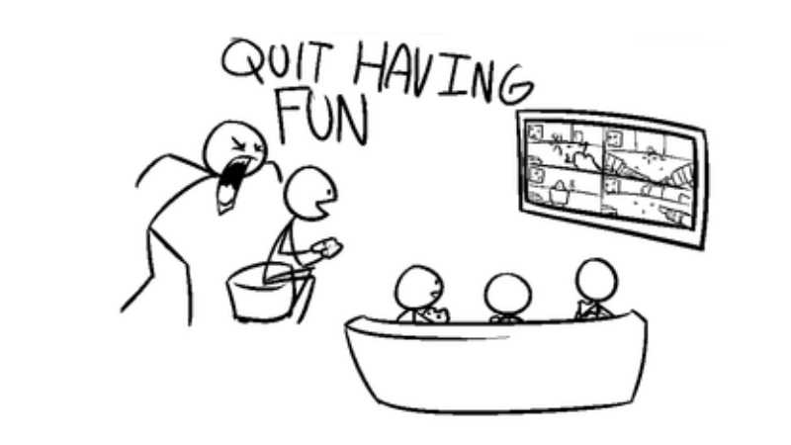
Properties of Wireless Channels Affect MAC Protocol Design
The good news: no more wires.
The bad news:
Nodes cannot detect collisions while sending. (you cannot talk and listen at the same time!)
Hidden and exposed terminals.
We cannot detect collisions while transmitting!

Slide 56
MAC for Wireless Channels: No Collision Detection
Channel is free, I can send my frame to B
My frame is colliding, better stop sending!
A
B
C
D
M
M

Slide 57
MAC for Wireless Channels: No Collision Detection
Bad news 1/2
Channel is free, I can send my frame to B
Collision not detected because incoming signal is orders of magnitude weaker than outgoing signal.
A
B
C
D
Outgoing signal too strong to detect collision

Slide 58
MAC for Wireless Channels: Carrier Sense has Limited Range
Bad news 2/2
Hidden Terminal
Channel is free, I can send my frame B
Stations sense that channel is idle, but their range is too short to detect a transmitting hidden terminal.
A
B
C
D
M
M
Range too short to detect channel is in use

Slide 59

MAC for Wireless Channels: Carrier Sense has Limited Range
Bad news 2/2
Exposed Terminal
Channel is in use, I cannot send my frame to D
Channel is free, I can send my frame A
Stations sense that channel is in use, but the exposed terminal’s signal would not reach and interfere with the intended recipient.
A
B
C
D
M
M
There would be no collision at recipients

Slide 60
Multiple Access with Collision Avoidance (MACA)
An approach to solve the hidden terminal and exposed terminal problem.
Example: B wants to send to A.
A
B
C
D
Send CTS
Send RTS
Did not receive CTS, so clear to send to D.
Receive RTS
Receive RTS
Waiting

Slide 61
CSMA/CA (Collision Avoidance)
Physical channel sensing.
Sense if the channel is in use. Wait for channel to become idle.
Virtual channel sensing.
Frames carry a Network Allocation Vector (NAV) that indicates the length of the exchange.
Wait for end of exchange.
Data + Ack

Slide 62
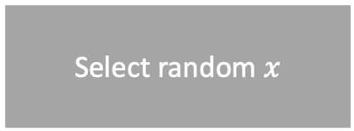
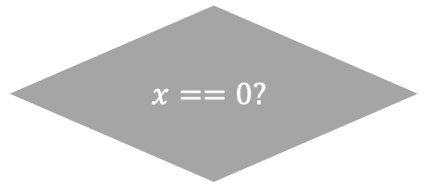
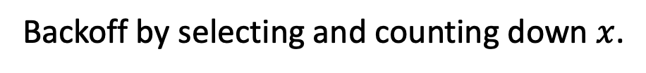
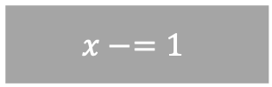
CSMA/CA
Starts with a back-off, regardless of collision
Select random $x$
Channel free?
Countdown paused when other channel is occupied
No
Yes
No
$$x==0?$$
$$x−=1$$
Skip slot
Yes
Send
Backoff by selecting and counting down $x$.

Slide 63

CSMA/CA Example
Virtual channel sensing: B and C keep waiting after A is done sending its frame. Expecting Ack.
D
A
Backoff
M
A
Starts with a back-off, regardless of collision
Ready
Backoff complete
A to D
D to A
B
Wait
Backoff
Wait
Backoff
M
Ready
Backoff complete
C
Wait
Backoff
M
A
Ready
Backoff complete

Slide 64
MAC Sublayer Outline
ALOHA & Slotted ALOHA
CSMA
1-persistent
nonpersistent
p-persistent
CSMA/CD
802.3 Ethernet
Ethernet Switching
MAC for Wireless
Hidden Terminal
Exposed Terminal
CSMA/CA
802.11 WiFi
Collision-Free Protocols
Basic Bit-Map
Token Ring
Binary Countdown

Slide 65
Medium Access Control in … 802.11
Stations cannot detect collisions while they occur.
Relies on ACKs to determine if collision occurred.
Can use RTS/CTS, but usually does not.
Instead uses a protocol called CSMA/CA. CA: Collision Avoidance.
If ACK is lost, sender assumes frame was lost; retransmits frame

Slide 66
Core elements of CSMA/CA
Physical channel sensing.
Sense if the channel. Wait for channel to become idle.
Virtual channel sensing.
Frames carry a Network Allocation Vector (NAV) that indicates the length of the exchange.
Wait for end of exchange.
Data + Ack

Slide 67
CSMA/CA
Starts with a back-off, regardless of collision
Select random $x$
Channel free?
Countdown paused when other channel is occupied
No
Yes
No
$$x==0?$$
$$x−=1$$
Skip slot
Yes
Send
Backoff by selecting and counting down $x$.

Slide 68
CSMA/CA Example
Virtual channel sensing: B and C keep waiting after A is done sending its frame. Expecting Ack.
D
A
Backoff
M
A
Starts with a back-off, regardless of collision
Ready
Backoff complete
A to D
D to A
B
Wait
Backoff
Wait
Backoff
M
Ready
Backoff complete
C
Wait
Backoff
M
A
Ready
Backoff complete

Slide 69

Power saving in 802.11
Multiple methods possible
Beacon frames
Automatic Power Save Delivery (APSD)
…
APSD example:
M
M
M
M
M
M
M
M
M
M

Slide 70
802.11 Infrastructure mode
Other networks

Slide 71
802.11 Ad-hoc networks
Q: Can you think of a (dis)advantage?

Slide 72
802.11 frames
Bytes:
2
2
6
6
6
2
0-2312
4
Frame control
Duration
Address 1
Destination
Address 2
Source
Address 3
Seq
Data
CRC
Version
Type
…
To DS
From DS
Power Management
…
More data
Protected

Slide 73
802.11 frames
Bytes:
2
2
6
6
6
2
0-2312
4
Frame control
Duration
Address 1
Destination
Address 2
Source
Address 3
Seq
Data
CRC
Version
Type
…
To DS
From DS
Power Management
…
More data
Protected
Available for other types of frames in future versions of the protocol.

Slide 74
802.11 frames
Bytes:
2
2
6
6
6
2
0-2312
4
Frame control
Duration
Address 1
Destination
Address 2
Source
Address 3
Seq
Data
CRC
Version
Type
…
To DS
From DS
Power Management
…
More data
Protected
Indicates a control, management, or data frame.

Slide 75
802.11 frames
Bytes:
2
2
6
6
6
2
0-2312
4
Frame control
Duration
Address 1
Destination
Address 2
Source
Address 3
Seq
Data
CRC
Version
Type
…
To DS
From DS
Power Management
…
More data
Protected
Indicates frames to and from the access points (distribution system) respectively.

Slide 76
802.11 frames
Bytes:
2
2
6
6
6
2
0-2312
4
Frame control
Duration
Address 1
Destination
Address 2
Source
Address 3
Seq
Data
CRC
Version
Type
…
To DS
From DS
Power Management
…
More data
Protected
Indicates that the sender will enter power save mode.

Slide 77
802.11 frames
Bytes:
2
2
6
6
6
2
0-2312
4
Frame control
Duration
Address 1
Destination
Address 2
Source
Address 3
Seq
Data
CRC
Version
Type
…
To DS
From DS
Power Management
…
More data
Protected
Indicates that the sender has more frames for the receiver.

Slide 78
802.11 frames
WPA2 uses encryptions based on AES (Advanced Encryption Standard)
Authentication uses username+password (e.g., Eduroam), or only a password (e.g., your wireless network at home).
Bytes:
2
2
6
6
6
2
0-2312
4
Frame control
Duration
Address 1
Destination
Address 2
Source
Address 3
Seq
Data
CRC
Version
Type
…
To DS
From DS
Power Management
…
More data
Protected
Indicates that the data is encrypted.

Slide 79
802.11 frames
Bytes:
2
2
6
6
6
2
0-2312
4
Frame control
Duration
Address 1
Destination
Address 2
Source
Address 3
Seq
Data
CRC
Stations use the duration to update their Network Allocation Vector (NAV).

Slide 80
802.11 frames
Bytes:
2
2
6
6
6
2
0-2312
4
Frame control
Duration
Address 1
Destination
Address 2
Source
Address 3
Seq
Data
CRC
Q: Why a third address?

Slide 81
Access point forwards frame to recipient
Address 1
Destination
M
Address 2
Source
Address 3
M

Slide 82
Access point forwards frame to recipient
Internet-connected router
Address 1
Destination
M
Address 3
Address 2
Source
M

Slide 83
802.11 frames
Q: Reliable delivery?
Bytes:
2
2
6
6
6
2
0-2312
4
Frame control
Duration
Address 1
Destination
Address 2
Source
Address 3
Seq
Data
CRC
Q: Error detection/correction?
Q: Why a third address?

Slide 84
MAC Layer Summary
Channel free?
No
Random back-off
Yes
Send
Yes
Collision?
Multiplexing on the link layer
Contention and coordination
Centralized and decentralized protocols
Properties: bandwidth efficiency, latency, complexity.
Protocols and mechanisms
Carrier Sense
Collision Detection, 1-persistent, nonpersistent, p-persistent
Collision Avoidance, MACA, CSMA/CA
Collision-free protocols, Basic bitmap, Token ring, Binary countdown
Q: Why useful?
Wireless Channels
Limited Radio Range
Hidden terminals and Exposed terminals
Switching
Routing on the link layer
No MAC protocol needed when used on full-duplex wired channels
No
Q: Which is better?
Q: How to know where to send frames?
A
B
C
D
Q: Why not used on wireless channels?
T
T
Token →
T
T
M
M
T
T

Slide 85
MAC Sublayer Outline
ALOHA & Slotted ALOHA
CSMA
1-persistent
nonpersistent
p-persistent
CSMA/CD
802.3 Ethernet
Ethernet Switching
MAC for Wireless
Hidden Terminal
Exposed Terminal
CSMA/CA
802.11 WiFi
Collision-Free Protocols
Basic Bit-Map
Token Ring
Binary Countdown

Slide 86
Collision-Free Protocols
Replacing contention with coordination
Instead of detecting collisions, why not prevent collisions?
Protocol examples:
Basic Bit-Map Protocol
Token Ring
Binary Countdown

Slide 87
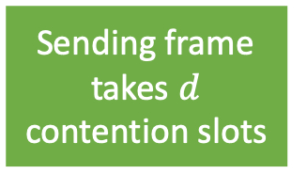
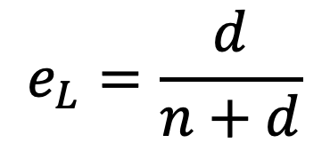
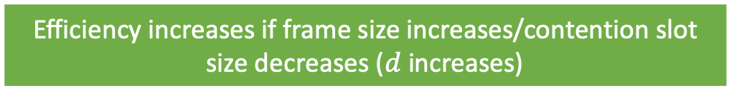
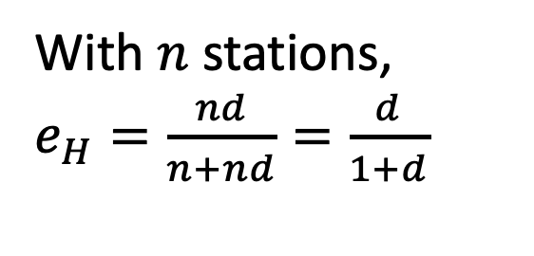
The Basic Bit-Map Protocol
Q: What is the efficiency of this protocol?
With $n$ stations, $e_{H}=\frac{nd}{n+nd}=\frac{d}{1+d}$
An example of a collision-free protocol.
Stations that want to transmit send a ‘1’ in their slot.
Efficiency increases if frame size increases/contention slot size decreases ($d$ increases)
0
1
2
3
Frame from 1
Frame from 3
0
1
2
3
Frame from 0
1
1
Frame from 1
Frame from 3
1
Frame from 0
$$e_{L}=\frac{d}{n+d}$$
If a station wants to transmit, it sends a 1
Stations transmit their frames in order
Contention slot takes 1 time unit
Sending frame takes $d$ contention slots

Slide 88
Token Ring
Station with token is allowed to send frame, pass on token
Q: What is the efficiency of this protocol?
A collision-free protocol.
Similar to the basic bit-map protocol.
All stations send in a predefined order.
T
T
Physical network layout need not be a ring
Token →
T
T
A
B
C
D
M
M
T
T
T

Slide 89
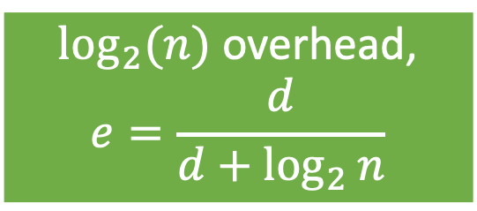
Binary countdown
Q: What is the trade-off these protocols make?
$\log_{2}⁡(n)$ overhead,
$$e=\frac{d}{d+\log_{2}{n}}$$
Example: Stations 0, 2, and 3 want to send a frame
Q: Disadvantage of this protocol?
Station 0 gives up. Higher numbered station wants to send.
Station 0 (00)
0
0
0
0
frame
Station 1 (01)
Station 2 gives up
Station 2 (10)
1
0
1
0
frame
Station 3 (11)
1
1
frame

Slide 90
Computer Networks X_400487
Lecture 5
Chapter 4: Medium Access Control
Lecturer: Jesse Donkervliet
Includes slides from Vlad Cursaru

Slide 91
Extra Slides

Slide 92
Medium Access Control Bluetooth

Slide 93
Bluetooth Protocol Stack
No fixed set of protocols. Instead, profiles define the set of protocols for a given application.
25 profiles, including headset, intercom, streaming audio, remote control, personal area network, and others.

Slide 94
Bluetooth Protocol Stack
Applications
RFcomm
…
Service
discovery
L2CAP
Host-controller interface
Link Manager
Link Control
(Baseband)
Host-controller interface separates chip features from device features.
Radio

Slide 95
Bluetooth Protocol Stack
Applications
Different profiles for different types of applications.
Headset Profile
Remote Control Profile
RFcomm
…
Service
discovery
L2CAP
Host-controller interface
Link Manager
Link Control
(Baseband)
Radio

Slide 96
Medium Access Control in … Bluetooth
Radio layer
Uses adaptive frequency hopping in 2.4GHz band.
Link layer
TDM with timeslots for master and slaves.
Synchronous CO for periodic slots in each direction.
Asynchronous CL for packet-switched data.
Links undergo pairing (user confirms passkey/PIN) to authorize them before use.
Q: How to prevent interference with 802.11?
Connectionless or connection-oriented depending on the application.

Slide 97



Medium Access Control in … Bluetooth
A Bluetooth network is called a piconet.
Secondaries may be asleep (parked) to save power.
S
P
S
S
S

Slide 98
Bluetooth piconet
Two piconets can be bridged into a scatternet.
S
S
P
S
P
S
Secondary device used as bridge
S
S
S

Slide 99
Bluetooth frames
Uses multiple types of frames, similar to 802.16.
Bluetooth frame (1x data rate)
Bits:
72 54 0-2744
Access code
Header
Data

Slide 100
Bluetooth frames
Uses multiple types of frames, similar to 802.16.
Bluetooth frame (1x data rate)
Bits:
72 54 0-2744
Access code
Header
Data
Used to identify primary device.

Slide 101
Bluetooth frames
Uses multiple types of frames, similar to 802.16.
Bluetooth frame (1x data rate)
Bits:
72 54 0-2744
Access code
Header
Data
Addr
Type
F
A
S
CRC
Bits: 3 4 1 1 1 8
Header repeated three times

Slide 102
Bluetooth frames
Uses multiple types of frames, similar to 802.16.
Bluetooth frame (1x data rate)
Bits:
72 54 0-2744
Access code
Header
Data
Used to identify secondary device.
Addr
Type
F
A
S
CRC
Bits: 3 4 1 1 1 8
Header repeated three times

Slide 103
Bluetooth frames
Uses multiple types of frames, similar to 802.16.
Bluetooth frame (1x data rate)
Bits:
72 54 0-2744
Access code
Header
Data
Identifies frame types such as SCO or ACL
Addr
Type
F
A
S
CRC
Bits: 3 4 1 1 1 8

Slide 104
Bluetooth frames
Uses multiple types of frames, similar to 802.16.
Bluetooth frame (1x data rate)
Bits:
72 54 0-2744
Access code
Header
Data
Buffer full. Secondary cannot receive more data.
Addr
Type
F
A
S
CRC
Bits: 3 4 1 1 1 8

Slide 105
Bluetooth frames
Uses multiple types of frames, similar to 802.16.
Bluetooth frame (1x data rate)
Bits:
72 54 0-2744
Access code
Header
Data
Piggybacked acknowledgement
Addr
Type
F
A
S
CRC
Bits: 3 4 1 1 1 8

Slide 106
Bluetooth frames
Uses multiple types of frames, similar to 802.16.
Bluetooth frame (1x data rate)
Bits:
72 54 0-2744
Access code
Header
Data
Used for flow control.
Addr
Type
F
A
S
CRC
Q: What is the window size?
Bits: 3 4 1 1 1 8

Slide 107
Bluetooth frames
Enhanced data rates send faster but for the same time.
Bluetooth frame (2x or 3x data rate)
Bits:
72 54 16 0-8184 2
Access code
Header
Guard/Sync
Data
Trailer
Addr
Type
F
A
S
CRC
Bits: 3 4 1 1 1 8

Slide 108
Medium Access Control RFID

Slide 109
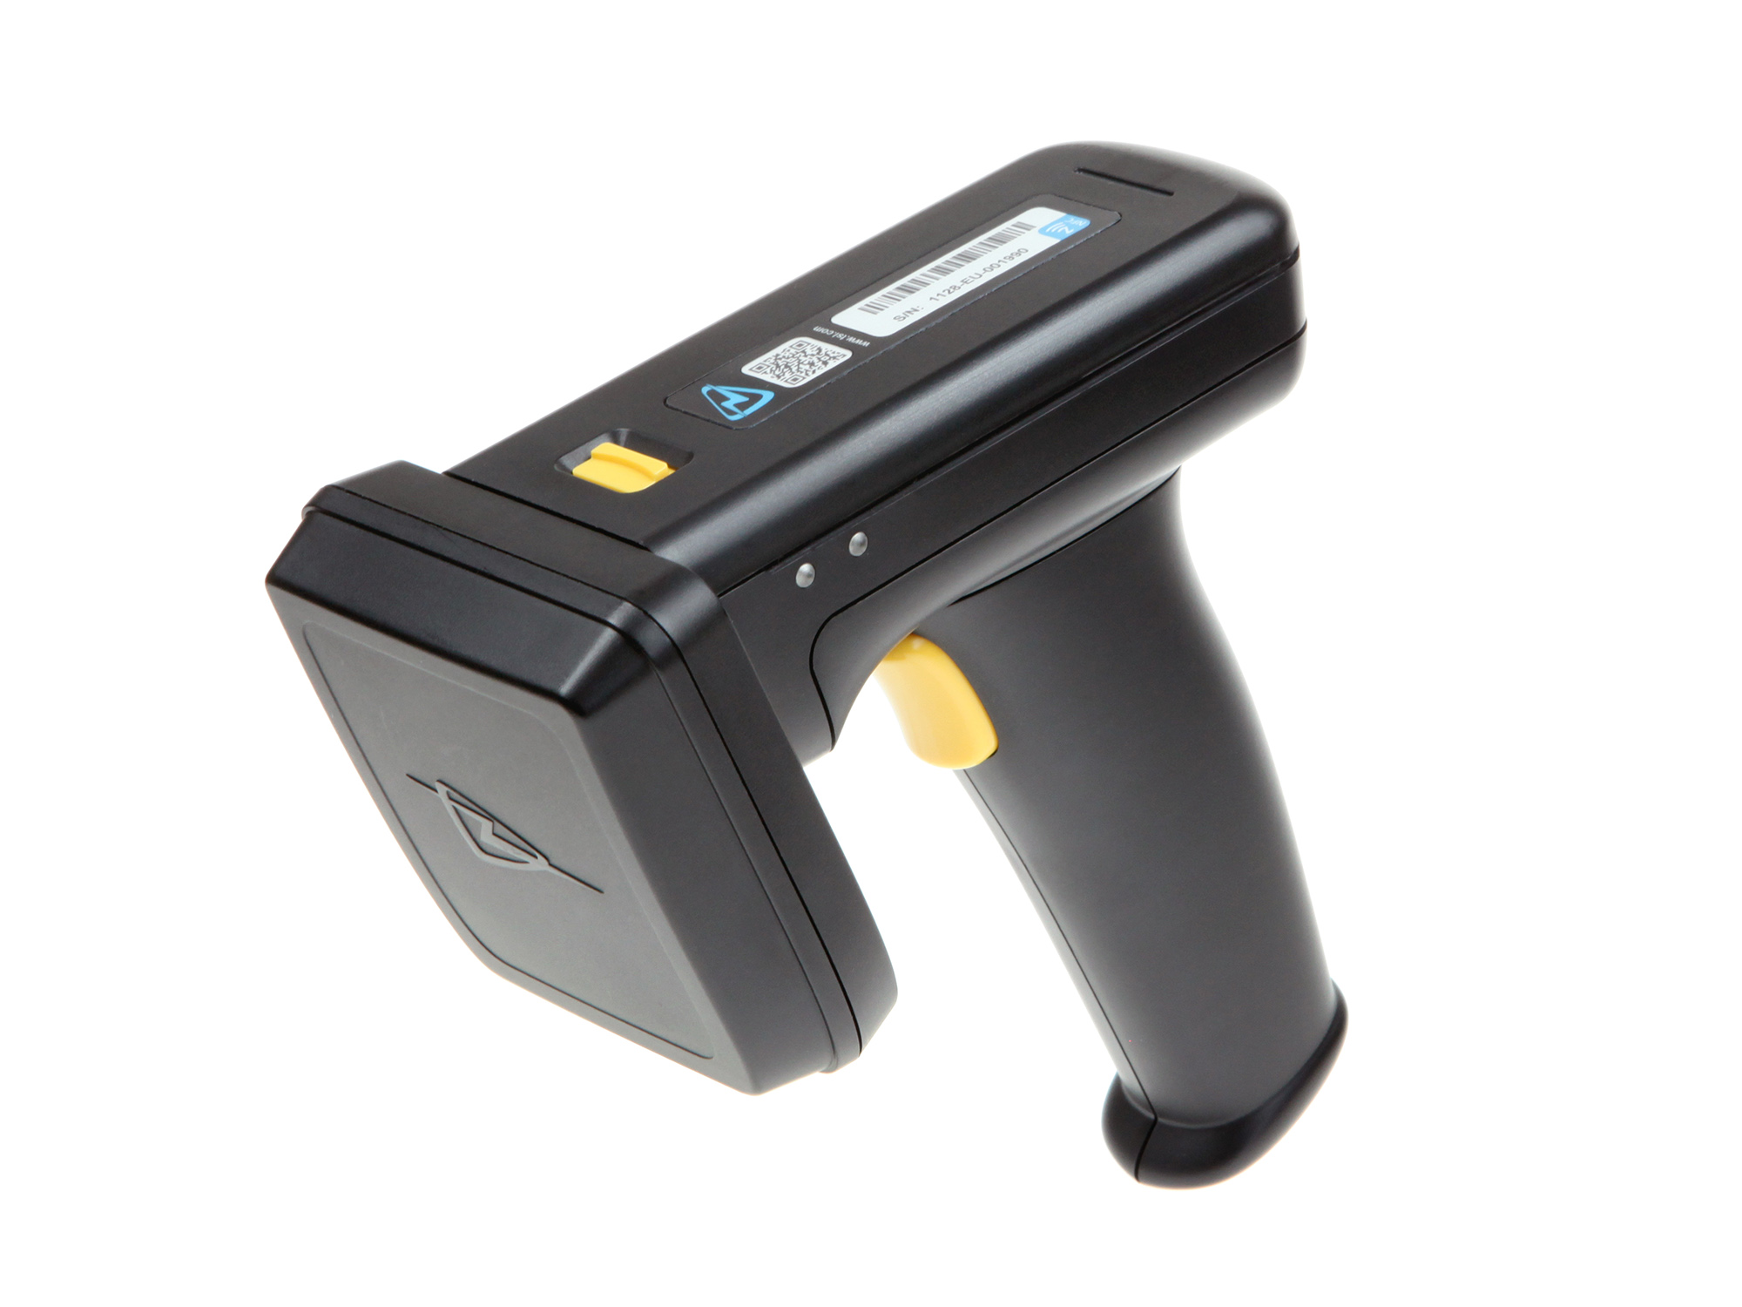
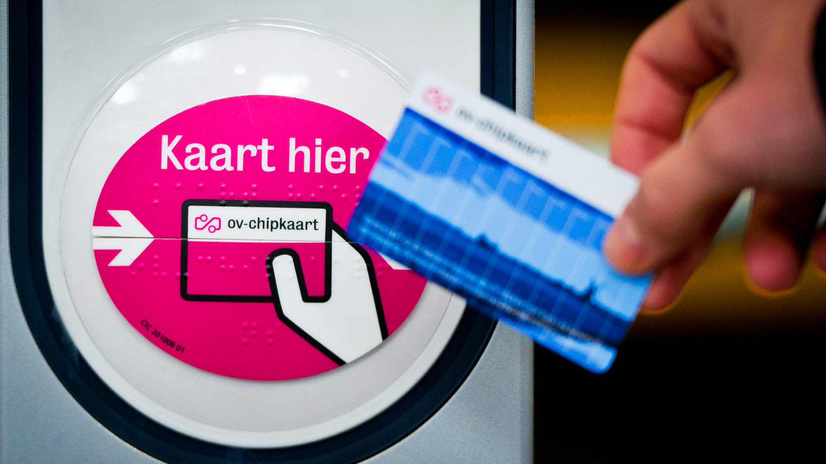
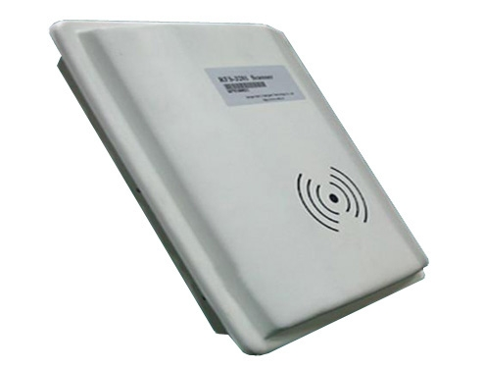
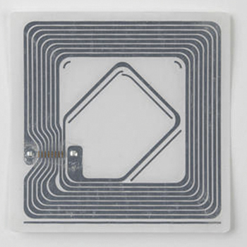
RFID Readers
Stationary reader
Mobile reader

Slide 110
Medium Access Control in … RFID
RFID uses readers and tags. Reader in charge of medium access control. Tags reply to requests.
Tags have no battery. Use reader signal to power reply

Slide 111
Medium Access Control in … RFID
RFID uses readers and tags. Reader in charge of medium access control. Tags reply to requests.
Tags have no battery. Use reader signal to power reply

Slide 112
RFID communication example
Q: Similar to a method we have seen last lecture?
Generation 2 Tag identification.
Reader sends query and sets slot structure.
Tags reply (RN16) in a random slot; may collide.
Reader asks one tag for its identifier. (ACK)
Process continues until no tags are left.
Query
Q
QRepeat
Q
QRepeat
Q
R
A
EPC
QRepeat

Slide 113
RFID request frame
RFID uses multiple types of frames. Example of a request-frame:
Bits:
4 1 2 1 2 2 1 4 5
Command
1000
DR
M
TR
Sel
Session
Target
Q
CRC

Slide 114
RFID request frame
RFID uses multiple types of frames. Example of a request-frame:
Bits:
4 1 2 1 2 2 1 4 5
Command
1000
DR
M
TR
Sel
Session
Target
Q
CRC
Used to configure physical layer properties (e.g., data rate).

Slide 115
RFID request frame
RFID uses multiple types of frames. Example of a request-frame:
Bits:
4 1 2 1 2 2 1 4 5
Command
1000
DR
M
TR
Sel
Session
Target
Q
CRC
Used to keep track of which tag is identified by which reader.
Allows tags to reply to multiple readers is the same area.

Slide 116
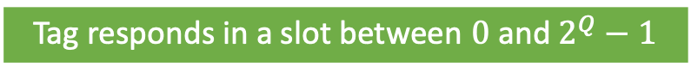
RFID request frame
RFID uses multiple types of frames. Example of a request-frame:
Bits:
4 1 2 1 2 2 1 4 5
Command
1000
DR
M
TR
Sel
Session
Target
Q
CRC
Limits random backoff values available to the tags.
Tag responds in a slot between $0$ and $2^{Q}−1$

